Slide 1
Department of Economics and Management
‘Marco Fanno’
University of Padova

Slide 2
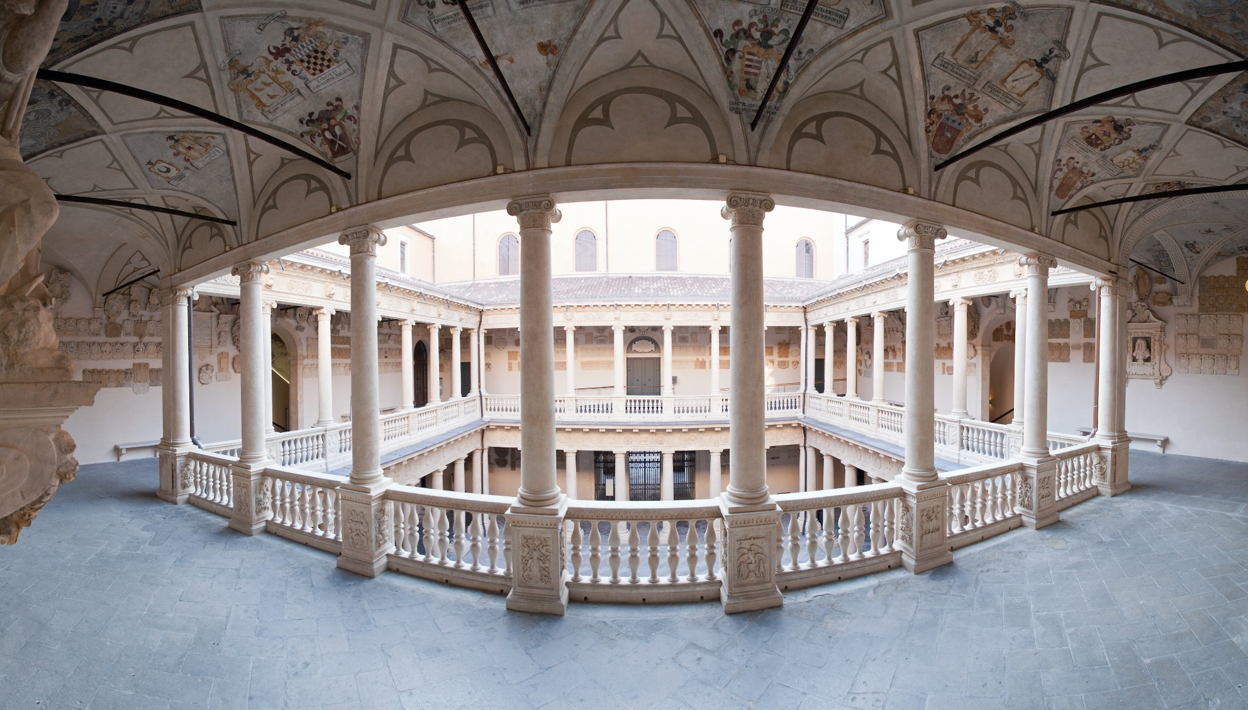
University of Padova
Founded in 1222, the University of Padova is one of Europe’s oldest and most prestigious multidisciplinary universities

Slide 3
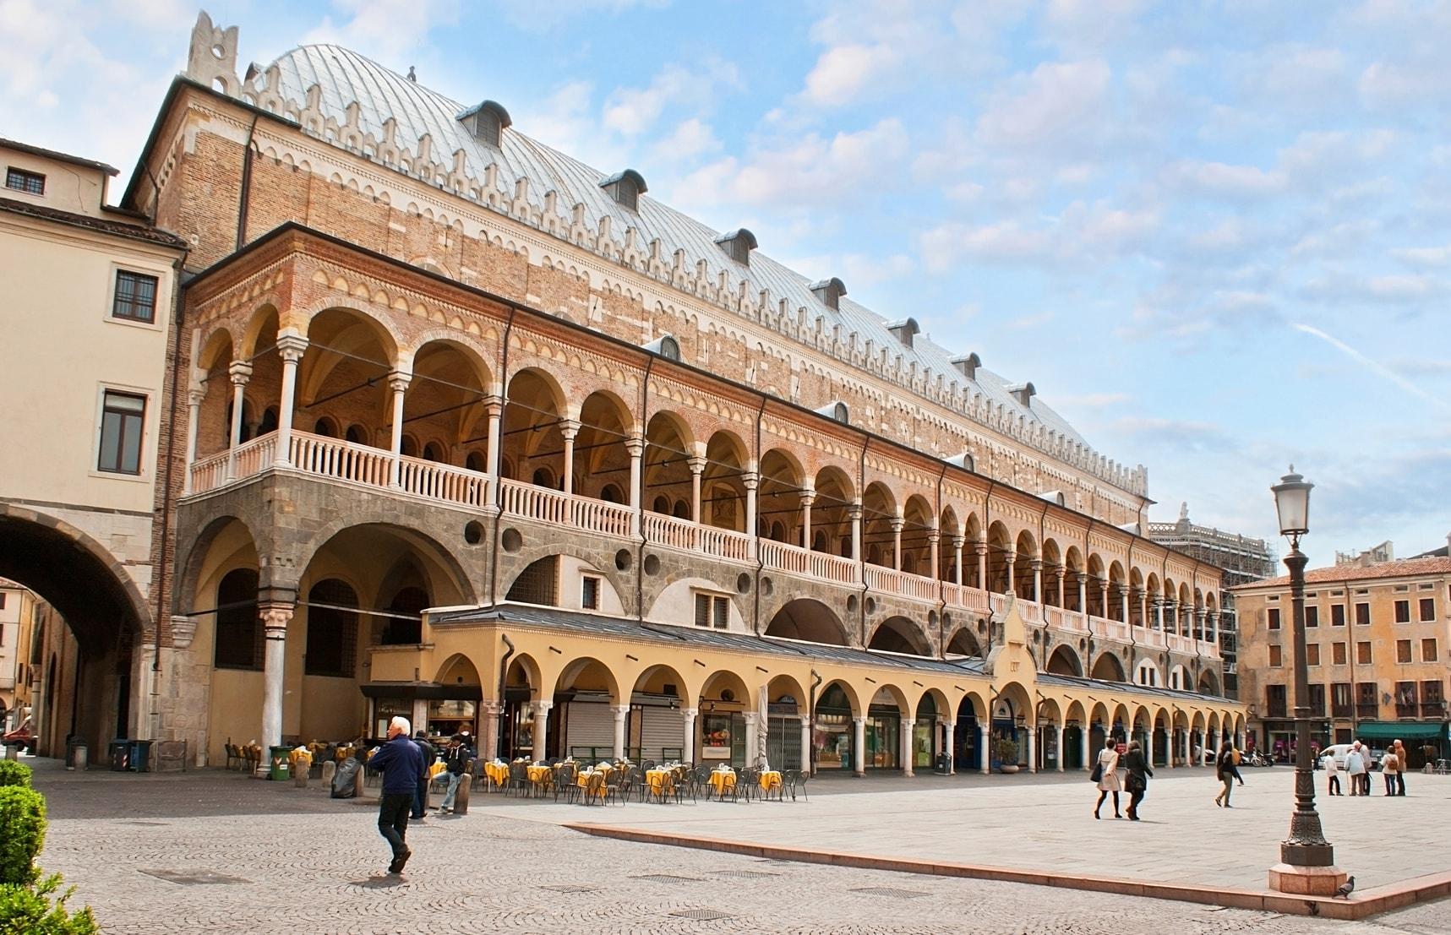
University of Padova
60,000 students, 1,300 PhD candidates,
2,200 academic staff & researchers
Lively, dynamic, and international environment in the heart of North Italy

Slide 4
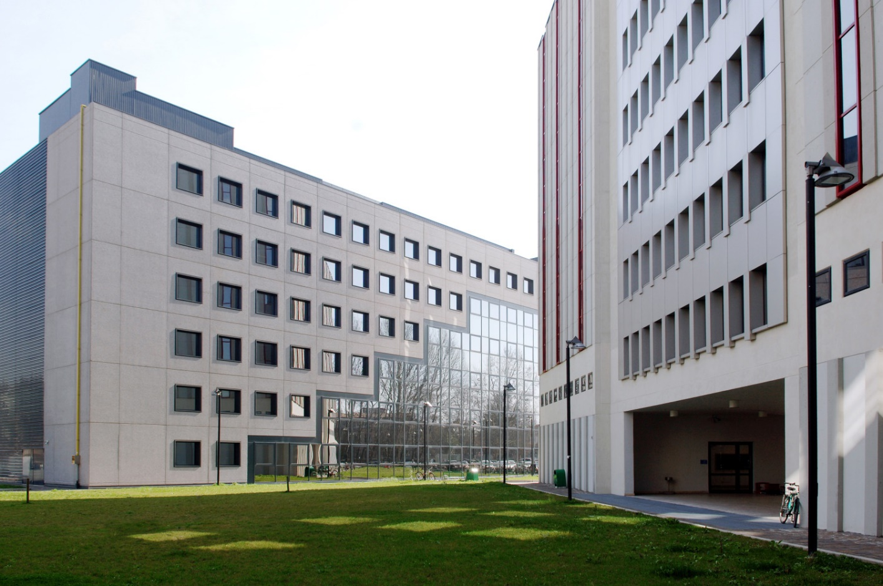
The Department of Economics
and Management
Founded in 1990 and is the youngest Department of the University of Padua.
Leading center among higher education institutions devoted to business and economic disciplines. It benefits of the advantages of being a young and dynamic organization inside a glorious tradition.
Two key strengths of the Department are : international exposure of its faculty members and students and the training opportunities offered as part of the curricula.

Slide 5
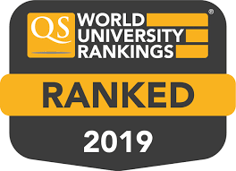
dSEA
We rank among the best Economics and Management departments in Italy taking into account quality of teaching, students' placement, and research excellence
“Department of Excellence”
Globally, we are among the top 250 universities in “Business & Economics” according to the Times Higher Education and top 200 in “Social Sciences and Management” according to the QS World University Ranking

Slide 6
Management Curriculum: Research Areas
Accounting & Finance
Corporate Governance: Boardroom Dynamics & Processes
Economics of Criminal Firms
Financial Information & Regulation in the Banking Industry
Non-Financial Disclosure and Corporate Social Responsibility
Strategy, Innovation & Organizational Behavior
Cluster evolutions & Internationalization Processes
Entrepreneurship, New Ventures & SMEs
Environmental Sustainability & Social Innovation
Innovation, Technology transfer & Spin-Offs
Organization, Jobs, Corporate Resilience
Operational Excellence: Supply Chain & Organizational Routines

Slide 7
Management Curriculum
Top-Tier Publications
Academy of Management Journal
British Journal of Management
Corporate Governance: an International Review
European Accounting Review
European Journal of Finance
Family Business Review
Journal of Business Research
Organization Science
Research Policy
Review of Accounting Studies
Strategic Management Journal

Slide 8
Economics Curriculum: Research Areas
Applied Economics: identify and measure causal effects in many domains
ageing, health, consumer behaviour
policy evaluation
labour and education economics
applied political economy

Slide 9
Economics Curriculum: Research Areas
Political Economy, Matching Theory, Experimental Economics
Trade and International Trade, Economic History
Regional and Urban Economics
Macroeconomics, Monetary Economics

Slide 10
Economics Curriculum: Research Areas
Industrial Organization, Energy and Environmental Economics
Healthcare Economics
Auctions Theory and Experiment, Procurements, Public Economics
Banking and Financial Markets

Slide 11
Economics
Top-Tier Publications
American Economic Review
Review of Economic Studies
Journal of the European Economic Association
Journal of Labour Economics
Journal of Development Economics
The Economic Journal
Journal of Public Economics
Journal of International Economics
Journal of Economic Theory
Journal of Health Economics
Theoretical Economics
European Economic Review
Games and Economic behavior
American Journal of Political Science

Slide 12
@Dipartimento di Scienze Economiche
e Aziendali - Università di Padova
@dsea.padova
@dsea_unipd
@dsea_unipd
@dsea unipd
www.economia.unipd.it

